Slide 1
BEGINNING EXCEL
Session 1

Slide 2
Overview of Microsoft Excel
Learn how to start Excel.
Become familiar with the Excel workbook.
Understand how to navigate worksheets.
Examine the Excel Ribbon.
Examine the right-click menu options.
Learn how to save workbooks.
Examine the Status Bar.
Become familiar with the features in the Excel Help window.

Slide 3
Starting Excel
1. Locate Excel on your computer.
2. Click Microsoft Excel to launch the Excel application where you are presented with workbook options to help get you
started.
3. Click the first option; “Blank Workbook”.

Slide 4
Excel for Windows vs Excel for Mac
The Excel for Windows and Excel for Mac software versions are very similar. Most of the features, tools and commands are available in both versions.
There are, however, some differences with the Excel interface.
There are also a few features that are not available in the Excel for Mac version.

Slide 5
The Excel Workbook
A workbook is an Excel file that contains one or more worksheets (referred to as spreadsheets).
Excel will assign a file name to the workbook, such as Book1, Book2, Book3, and so on, depending on how many new workbooks are opened.
Your screen may be slightly different based on the version you’re using.

Slide 6
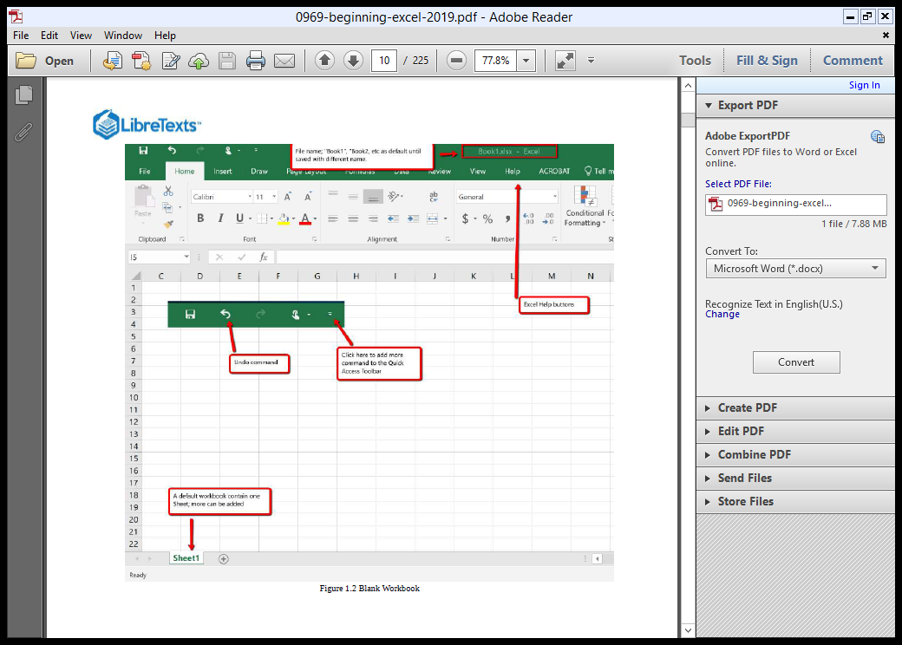
The Excel Workbook

Slide 7
Navigating Worksheets
Data are entered and managed in an Excel worksheet.
The worksheet contains several rectangles called cells for entering numeric and non-numeric data.
Each cell in an Excel worksheet contains an address, which is defined by a column letter followed by a row number.

Slide 8
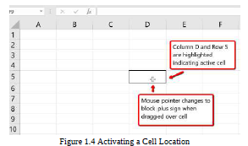
Navigating Worksheets
1. Place your mouse pointer over cell D5 and click.
2. Check to make sure column letter D and row number 5 are highlighted, as shown in Figure 1.4.

Slide 9
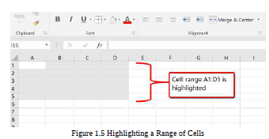
Navigating Worksheets
1. Move the mouse pointer to cell A1.
2. Click and hold the left mouse button and drag the mouse pointer back to cell D5.
3. Release the left mouse button. You should see several cells highlighted, as shown in Figure 1.5.

Slide 10
Navigating Worksheets
1. At the bottom of the screen, you’ll see a sheet tab indicated by “Sheet1″. Clicking on the + adds additional worksheets.
This is how you open or add a worksheets within a workbook. To see how this works, click on the + to add another worksheet so that you now have two sheets
2. Click the Sheet1 worksheet tab at the bottom of the worksheet to return to the worksheet.

Slide 11
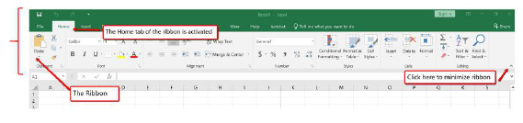
Examine the Excel Ribbon.
Excel’s features and commands are found in the Ribbon, which is the upper area of the Excel screen that contains several tabs running across the top.
Each tab provides access to a different set of Excel commands.

Slide 12
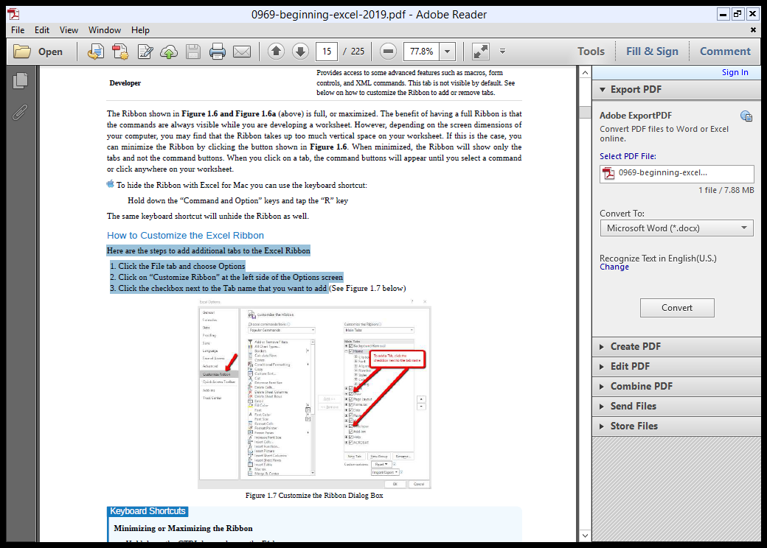
Examine the Excel Ribbon
How to Customize the Excel Ribbon
Here are the steps to add additional tabs to the Excel Ribbon
1. Click the File tab and choose Options
2. Click on “Customize Ribbon” at the left side of the Options screen
3. Click the checkbox next to the Tab name that you want to add

Slide 13
Examine the Excel Ribbon
QUICK ACCESS TOOLBAR AND RIGHT-CLICK MENU
The Quick Access Toolbar is found at the upper left side of the Excel screen above the Ribbon,
This area provides access to the most frequently used commands, such as Save and Undo.
You can also customize the Quick Access Toolbar by adding commands that you use on a regular basis.
By placing these commands in the Quick Access Toolbar, you do not have to navigate through the Ribbon to find them.
To customize the Quick Access Toolbar,
click the down arrow

Slide 14
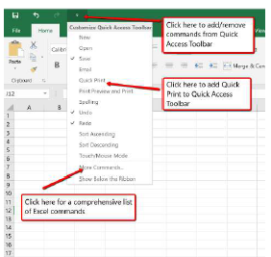
Examine the Excel Ribbon
QUICK ACCESS TOOLBAR AND RIGHT-CLICK MENU
This will open a menu of commands that you can add to the Quick Access Toolbar.
If you do not see the command you are looking for on the list, select the More Commands option.
In addition to the Ribbon and Quick Access Toolbar, you can also access many commands by right clicking anywhere on the worksheet

Slide 15
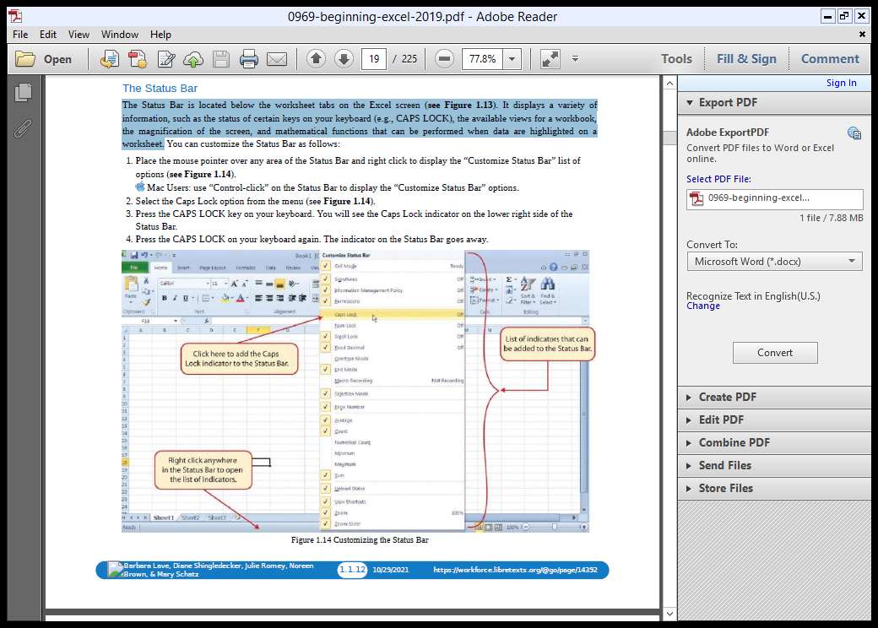
Examine the Excel Ribbon
THE STATUS BAR
The Status Bar is located below the worksheet tabs on the Excel screen,
It displays a variety of information, such as the status of certain keys on your keyboard (e.g., CAPS LOCK),
the available views for a workbook, the magnification of the screen, and mathematical functions that can be performed when data are highlighted on a worksheet.

